Slide 1
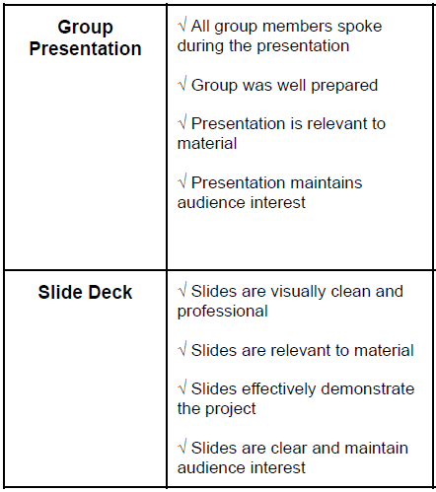
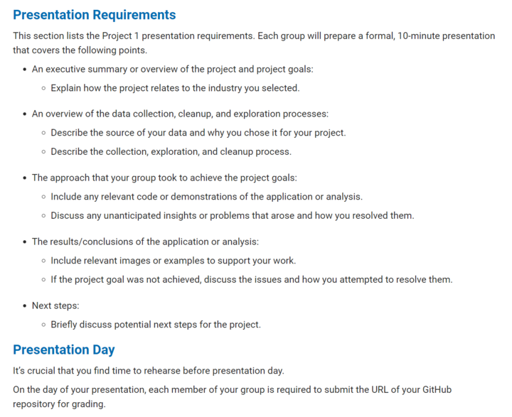
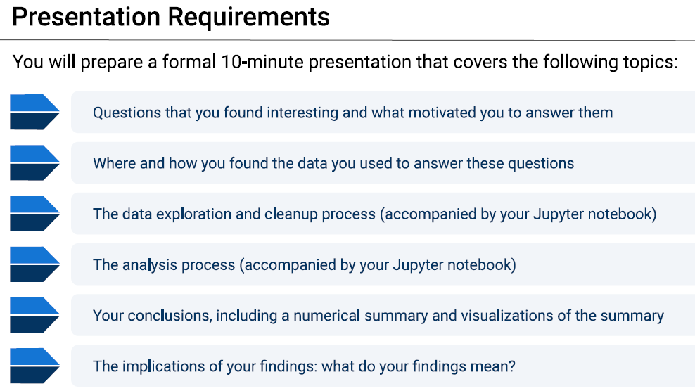
Presentation Requirements

Slide 2

Urban Real Estate Investing, US
Aaron Summers, Brannan Geshwind, Cory Selzer, Dulce Silva,
Rebekah Aldrich, Tait Ralston

Slide 3
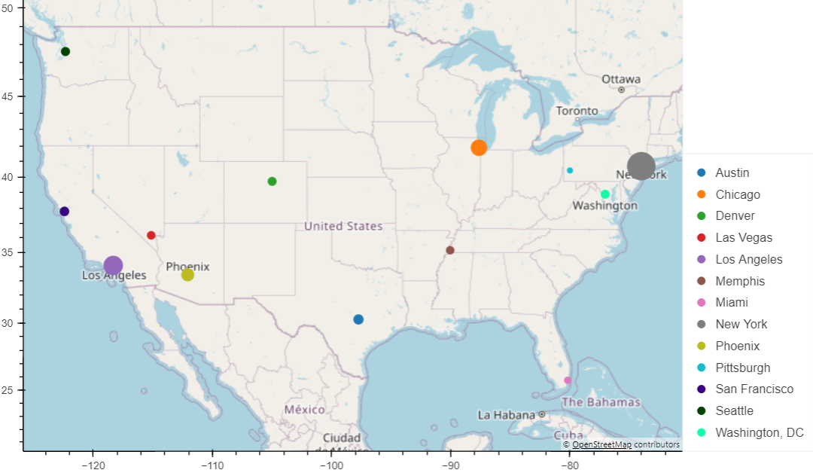
About us
We focus on real estate investing strategies within the US looking at trends across property value, property sales, population sizes, job markets, crime, schools, and other factors our clients find key to their situation
Notes:
Rebekah

Slide 4

Meet our client
BIO
Couple in early 50s with 2 fully independent children located in suburbia Tampa, FL.
Looking to invest remotely in urban/suburban properties as another source of income. As beginners, they want to focus on starter family housing and have asked us to recommend where to focus in the US.
Key care abouts
Target Cities
Housing up to 1500 sq. ft.
Housing up to 3 bedrooms
Homes, Townhomes, Condos
Evidence of population growth
Evidence of property value growth
Evidence rental prices competitive to mortgage
Austin, Chicago, Denver, Memphis, New York, San Francisco
Other Considerations
Good school districts
Low crime rates
Positive job market
Notes:
Rebekah

Slide 5
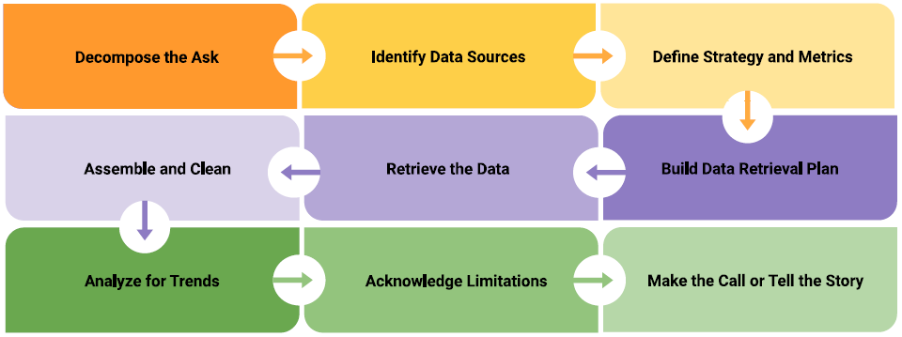
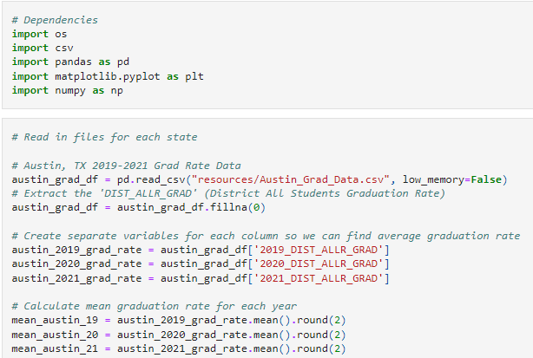
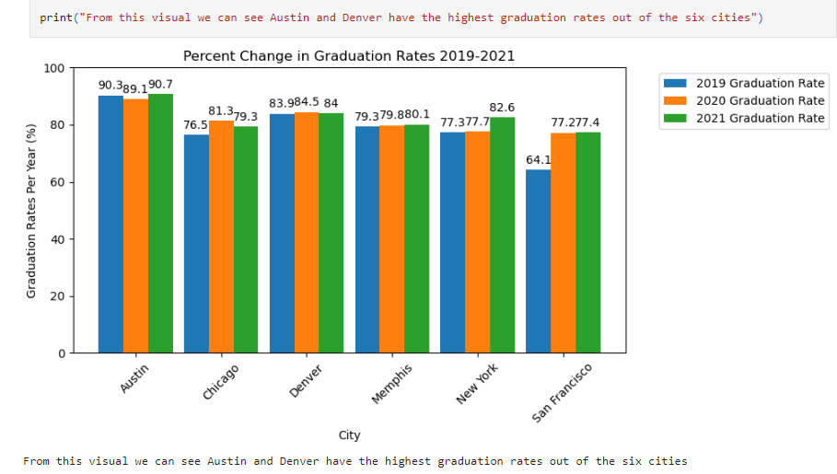
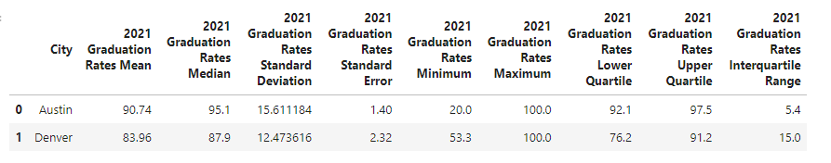
Process: School Notebook Demo
Notes:
Tait

Slide 6
Process Overview
Group: Brainstorm Project Ideas
Group: Define Ideal Asks
Individual: Prototyping by Ask
Group: Refine Ask (strategy / metrics)
Group: Brainstorm Data Sources
Group: Planning

Slide 7
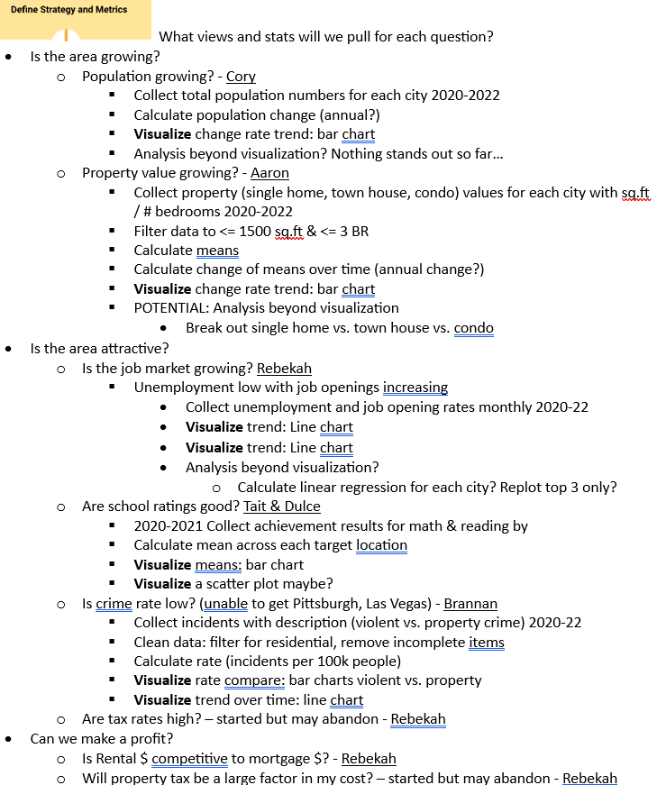
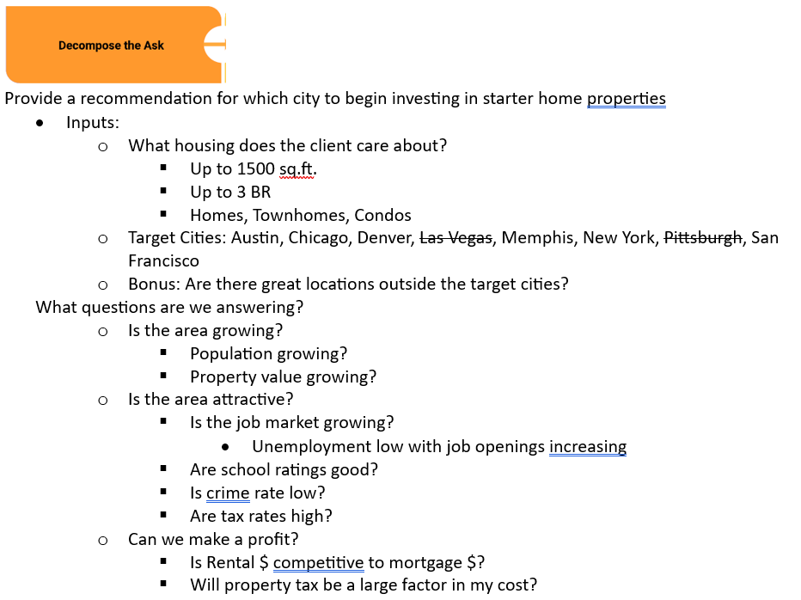
The Plan

Slide 8
Process Overview Continued
Individually/Partnering plan, gather, clean, analyze by ask
Individual/Partner: tell the story by ask
Group: Review asks as a whole
Group: Make the final call
Ask for additional support . Modifications given limitations
Group: Tell the story
Notes:
Analysis included:

Slide 9



Data Sources
Population Growth
Property Values
Census Data API
Census Data Wrapper
Used Census dependency within Jupyter Notebook. Limited dataset due to 2022 Census information being unavailable.
https://www.attomdata.com/
Used API to show house/sales in our 6 cities created Data Frames for each city Combined all cities the graph sales date by price
Profitability
Schools
Census Python API
Monthly vs. Annual data sets
Unable to limit scope for desired homes
Austin, Chicago, Denver, Memphis, New York City, San Francisco
Very descriptive education/school from each city/state found. Had to par down some of the files before importing due to spreadsheet complexity.
Crime
Job Market
<source>
<notes on using source>
U.S. Bureau of Labor Statistics API
Free registration highly recommended
Good documentation on potential calls
Inconsistent granularity on location level
Notes:
Aaron

Slide 10

Approach Highlights & Lessons Learned
Analysis Details
Lessons Learned
Working with reported rates
Know Your Limits
Collected data
Minor data cleaning
View trend over time with line chart
Use trend lines when “messy”
Use AOVA, T tests to verify differences
How messy is data source
Inconsistent reporting
Timeliness of outside communication
Git capability
Free Data Limitations
Working with reported values
Free API call restrictions
Inconsistent timeline availability
What is available? (e.g. graduation rate vs. school rating)
Maxing out our API call limit
Collected data
Cleaned data
Calculate key care abouts (e.g. mean, change rates)
Charted means
Calculated statistics to better understand population (e.g. standard deviations / quartiles)
How Did We React?
Leverage each other on time/qty limits
Shifted timelines but kept same length
Reduced target cities
Reduced crime scope (property specific)
Notes:
Dulce – focus on Lessons Learned
Top notes:
Data gathering and cleaning can be VERY time consuming (ATTOM API restrictions, Messy crime data)
Be flexible – keep communication ongoing with your clients!

Slide 11
POTENTIALLY Pull Data slides in from Additional Supporting Analysis Section

Slide 12

FINAL Recommendation: Denver, CO
Population Growth
Property Values
Third in population growth
…
Profitability
Attractive
Third in potential profitability growth
Top in job market
Maybe Top in Crime Rate
Second in graduation rates
Notes:
Cory

Slide 13
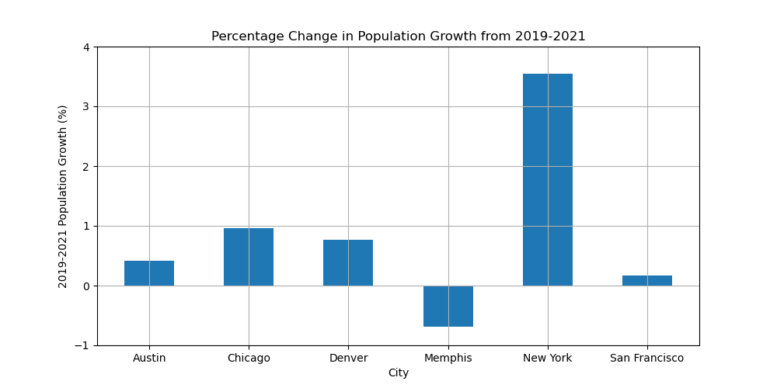
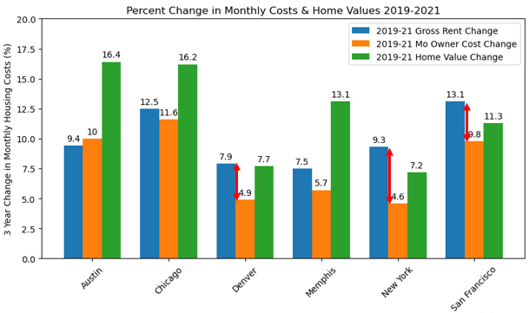
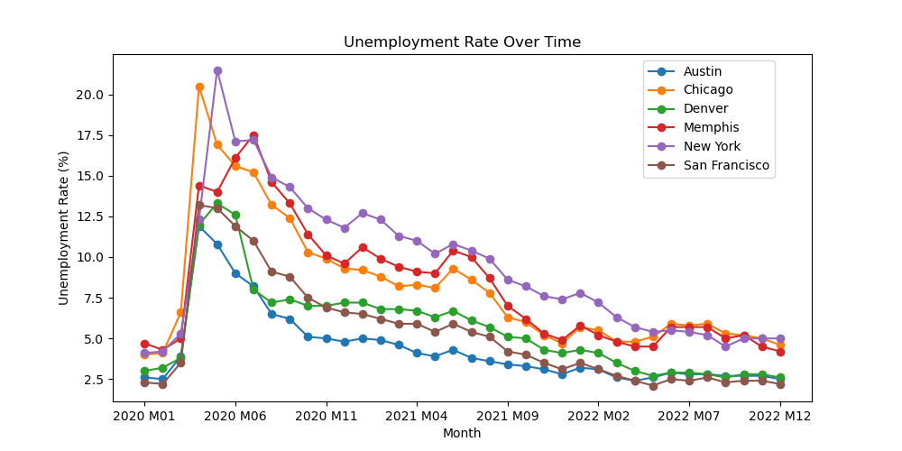
FINAL Recommendation: Denver, CO
Population Growth
Third in population growth
Profitability
Third in potential profitability growth
Attractive
Top in job market
Maybe Top in Crime Rate
Second in graduation rates
Notes:
Cory

Slide 14


Next Steps
Once have reduced target cities, further dive into specific location details(e.g. city vs. suburb; zip codes; specific schools)
Clarify Profitability
- Find mortgage + property tax costs to compare to rental for target housing
- Average time to re-coup investment money
- Long term vs. short term rental
Clarify attractiveness
- Pull property crime rate out from overall crime rate
- School performance on standardized test results
Notes:
Brannan

Slide 15
Additional Supporting Analysis

Slide 16

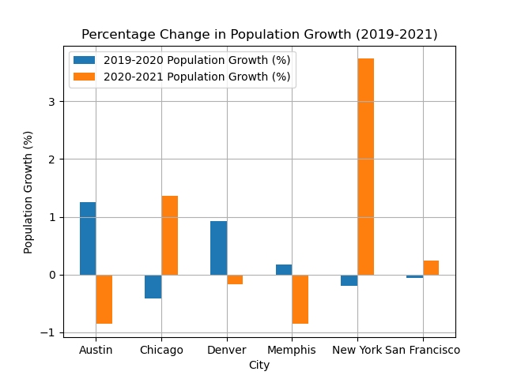
Population Analysis By growth Percentages
Sources: Census Data Wrapper, Census Data API
New York City
Shows the highest overall population growth for the years analyzed.
Chicago, Denver, Austin, san francisco
All show overall population growth in the same timeframe.
Memphis
Shows an overall decrease in population size for the years analyzed.
16

Slide 17
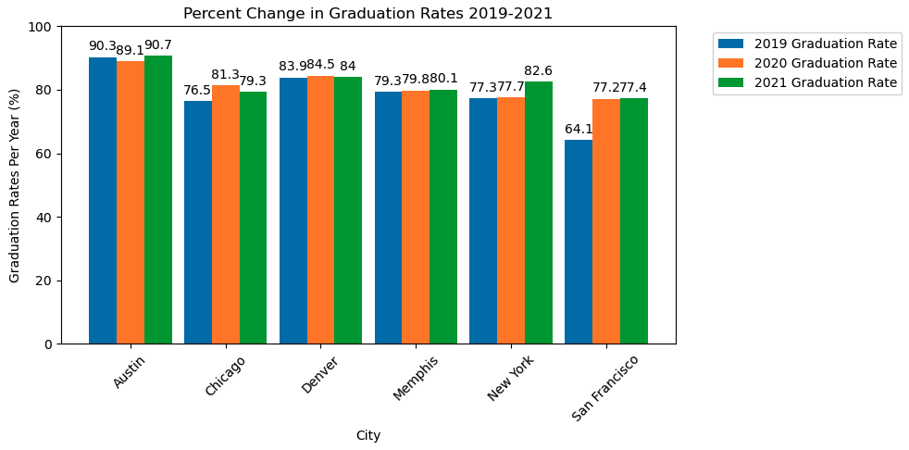
School Analysis By Graduation Rate Percentages
Sources: Austin, Chicago, Denver, Memphis, New York City, San Francisco
Austin, Denver
Show the best overall graduation rates in their schools for the analyzed years. The middle 50% of Austin schools have a graduation rate between 92.1 and 97.5. The middle 50% of Denver schools have a graduation rate between 76.2 and 91.2.
San Francisco
Show the greatest improvement in graduation rate percentage over the 3 years analyzed compared to the other cities.
Chicago, Denver
Show a decrease in graduation rate from the 2020 to 2021 school years.
17
Notes:
Tait –
As you can see in the cluster bar graph and the summary of statistical analysis, our top 2 city choices for school graduation rate percentage were Austin and Denver.

Slide 18

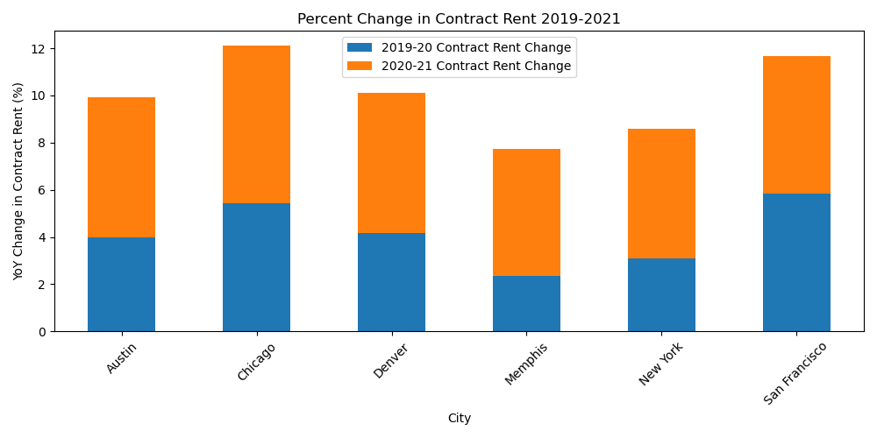
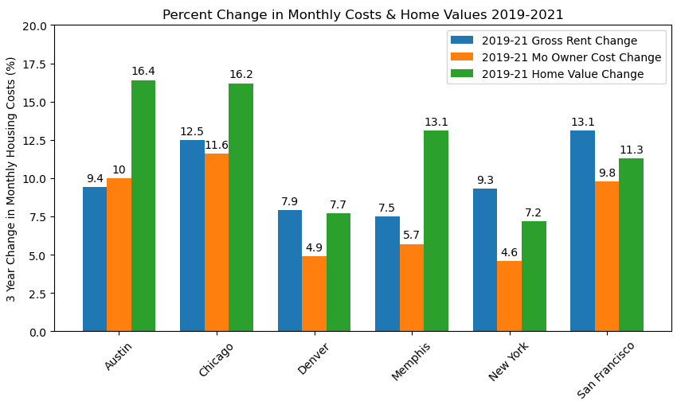
Profitability Growth
Source: Census Python API
San Francisco (Chicago, Denver)
Considering rental pricing, mortgage, and home value growth, San Francisco is the most well-rounded performer out of the target cities.
Chicago and Denver are runner ups.
Chicago, San Francisco
Show the most growth in rental prices with Austin and Denver in the next grouping.
New York, San Francisco, Denver
Show rental costs outpacing mortgage costs more than others with New York being the strongest.
Austin, Chicago
Show the most growth in home value with Memphis & San Francisco in the next highest grouping.
Notes:
https://www.census.gov/data/developers/guidance/api-user-guide.html

Slide 19
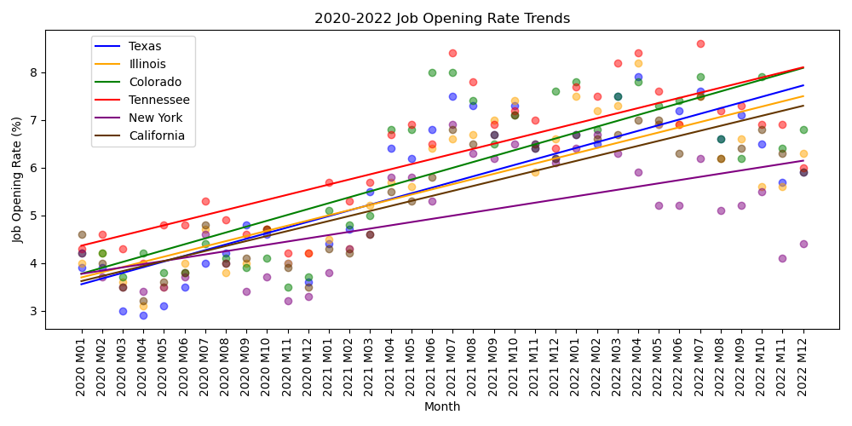
Job market trends
Source: U.S. Bureau of Labor Statistics
Denver, Colorado
Has the best overall job trend helping attract more people to the area compared to other target cities
Colorado, Tennessee, Texas
Have the highest job opening rate trends of the target states.
San Francisco, (Austin, Denver)
Have the lowest unemployment rates of the target cities.
Notes:
Other Notes:
Unemployment:
Denver, Austin, San Francisco are different (p-value: 0.178)
Denver & Austin are on the edge of being different (p-value: 0.053)
Job Openings:
Texas, Illinois, California are different (p-value: 0.854)
Texas and Illinois are different (p-value: 905)

Slide 20
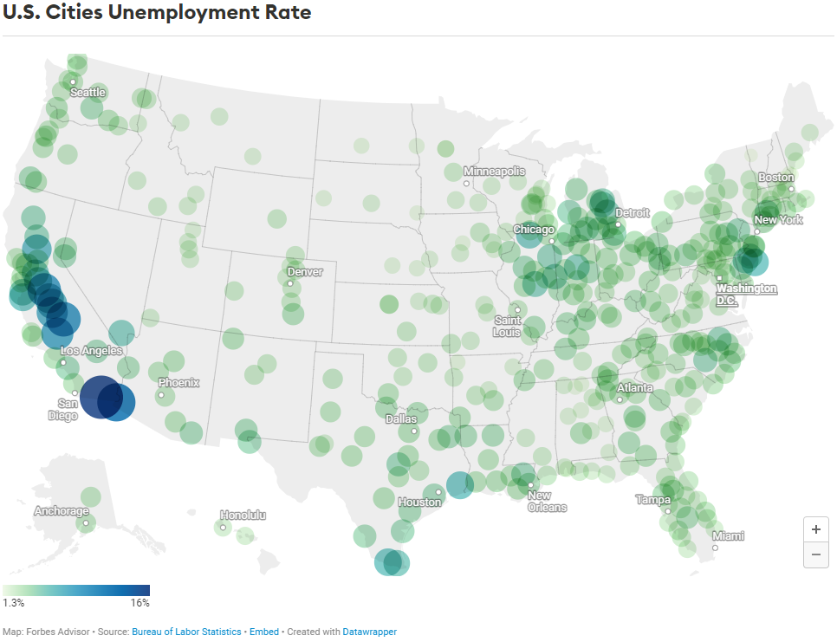
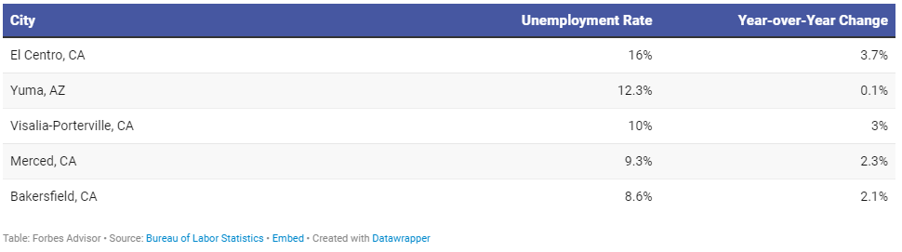
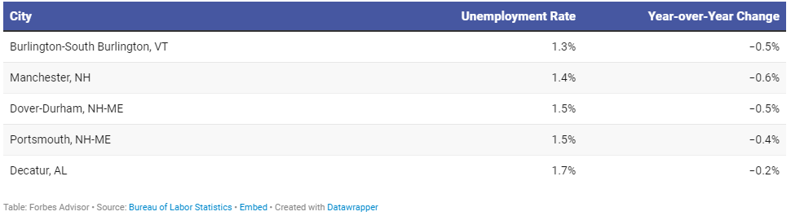
Unemployment rates across the united states
Highest Unemployment Rate
Lowest Employment Rate
Potential cities add for consideration:
Notes:
Source: https://www.forbes.com/advisor/personal-finance/unemployment-rates-by-city/#:~:text=The%20Bureau%20of%20Labor%20Statistics,Statistics%20Estimation%20Methodology%20(LAUS).

Slide 21

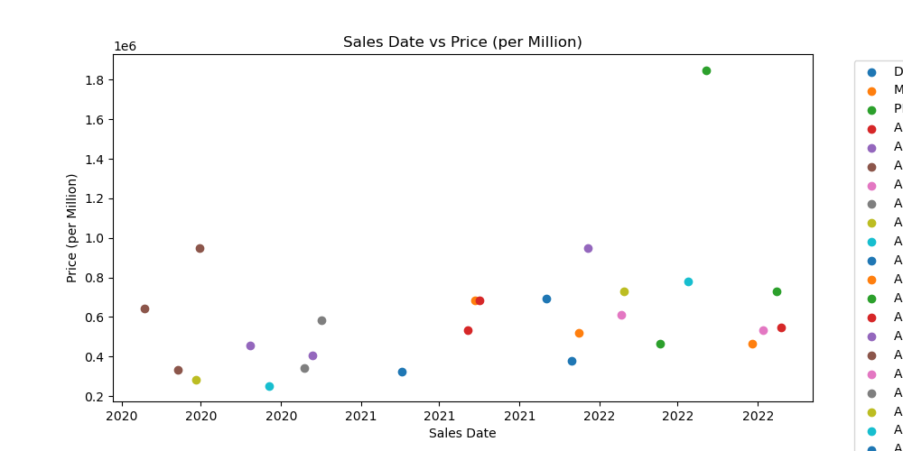


Topic trends
Optional: Sales trends
Optional: Houses Available to Buy
This chart shows the recent sales of house within our 6 cities, the houses also meet these parameters 1-3 bedrooms, square foot max of 1500 sq. ft, and zoned residential with sales in a range from 1/1/2020-12/31/2022. We Got No results for Denver, Memphis, New York, and San Francisco.
A Chart was not able to be made because there were no houses available in any of the 6 cities that we searched and also met these parameters, are houses with 1-3 bedrooms, square foot max of 1500sq. ft. , and zoned residential.

Slide 22
topic trends
Optional Sub header
REPLACE THIS PIC with 1 or 2 charts!
Conclusion 1
…
Conclusion 2
…
Conclusion 1
…

Slide 23

trend comparison
Optional Subheader
Optional Subheader2
Optional Subheader3
Key Details
Key Details2
Key Details3

Slide 24
Premade slides after this!

Slide 25
Pitch deck
Mirjam Nilsson​​

Slide 26

About us
At Contoso, we empower farming communities to foster collaborative thinking to further drive workplace innovation. By closing the loop and leveraging ethical farming methods, we help businesses grow organically and nurture a consumer first mindset.

Slide 27
problem
Market gap
Customers
Organic agriculture continues to be consumer driven, but we're seeing a lapse of availability in the market for organic products
6.6% increase of retail sales of organic food proves that there's consumer interest for more organic produce
Costs
Usability
Loss of sales by not offering organic produce selection
Retail organic food sales were up by $112 billion in 2019
Financials
Customers want something that's healthy and available to pick up at their local supermarket or area

Slide 28


Product overview
Unique
First to market
Tested
Authentic
Only product specifically dedicated to the agricultural market
First beautifully designed product that's both stylish and functional
Conducted testing with young farmers in the area
Designed with the help and input of agricultural experts in the field

Slide 29

Product Benefits
Cool and stylish product​
Areas for community connections ​
Online store and market swap

Slide 30
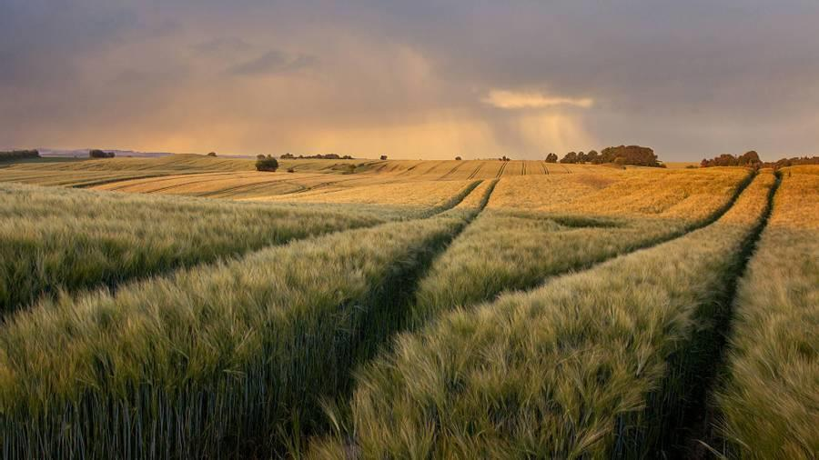
Company Overview

Slide 31

Business model
research
We based our research on market trends and social media​
abstract
We believe people need more products specifically dedicated to this niche market​
design
Minimalist and easy to use ​

Slide 32

Market overview
Opportunity to build​
Fully inclusive market
Total addressable market​
$3B​
Freedom to invent​
Selectively inclusive market​
Serviceable available market​
$2B
Few competitors​
Specifically targeted market​
Serviceable obtainable market​
$1B

Slide 33

Market comparison
$3b
$2b
$1B
Opportunity to build
Freedom to invent
Few competitors
Addressable market​
Serviceable market​
Obtainable market​

Slide 34
Our competition
contoso
Competitors
Our product is priced below that of other companies on the market​
Design is simple and easy to use, compared to the complex designs of the competitors​
Affordability is the main draw for our consumers to our product​
Company A​ Product is more expensive​
Companies B & C ​ Product is expensive and inconvenient to use​
Companies D & E​ Product is affordable, but inconvenient to use

Slide 35
Competitive layout
convenient
contoso
A
Expensive​
affordable
B
D
C
E
Inconvenient​

Slide 36
Growth strategy
How we’ll scale in the future​
Feb 20xx
Roll out product to local farms in the region to help establish the product​
May 20xx
Release the product to the general public and monitor press and regional market trends​
Oct 20xx
Gather feedback from the agriculture and farming community to expand availability of the product​

Slide 37
Traction
Forecasting for success​
Metrics
Revenue by year
 | clients | orders | Gross avenue | Net revenue
20XX​ | 10​ | 1,100​ | $10,000​ | $7,000​
20XX​ | 20​ | 200​ | $20,000​ | $16,000​
20XX​ | 30​ | 300​ | $30,000​ | $25,000​
20XX​ | 40​ | 400​ | $40,000​ | $30,000​

Slide 38
2-year action plan
Get volunteers​
Gather feedback​
Deliver to consumers​
20XX
Jan
Feb
Mar
Apr
May
Jun
Jul
Aug
Sep
Oct
Nov
Dec
Run focus groups​
Test with farms​
Regional launch​
20XX
Jan
Feb
Mar
Apr
May
Jun
Jul
Aug
Sep
Oct
Nov
Dec

Slide 39

financials
 | Year 1 | Year 2 | year 3
Detailers​ | 5,000​ | 40,000​ | 160,000​ | ​
Users​ | 50,000​ | 400,000​ | 1,600,000​ | ​
Sales​ | 500,000​ | 4,000,000​ | 16,000,000​ | ​
Average Price per Sale​ | 75​ | 80​ | 90​ | ​
Revenue @ 15%​ | 5,625,000​ | 48,000,000​ | 216,000,000​ | ​
Gross Profit​ | 5,625,000​ | 48,000,000​ | 216,000,000​ | ​
Expenses​ | ​ | ​ | ​ | ​
Sales & Marketing​ | 5,062,500​ | 38,400,000​ | 151,200,000​ | ​
Customer Service​ | 1,687,500​ | 9,600,000​ | 21,600,000​ | 70%​
Product Development​ | 562,500​ | 2,400,000​ | 10,800,000​ | 10%​
Research​ | 281,250​ | 2,400,000​ | 4,320,000​ | 5%​
Total Expenses​ | 7,593,750​ | 52,800,000​ | 187,920,000​ | 2%​
EBIT | -1,968,750 | -4,800,000 | 28,080,000 | ​

Slide 40




Meet the team
Takuma Hayashi​​
Mirjam Nilsson​​
Flora Berggren​​
Rajesh Santoshi​​
President
Chief Executive Officer​
Chief Operations Officer​
VP Marketing​

Slide 41








Meet the team
Takuma Hayashi​
Mirjam Nilsson​
Flora Berggren​
Rajesh Santoshi​
President
Chief Executive Officer
Chief Operations Officer
VP Marketing
Graham Barnes
Rowan Murphy
Elizabeth Moore
Robin Kline
VP Product
SEO Strategist
Product Designer
Content Developer

Slide 42
Funding
12K
32K
14K
82K
Campaigns​
Angel investments​
Cash
Shares
Revenue obtained from online campaigns and door-to-door sales​
Amount obtained through other investors
Liquid cash we
have on hand
Number of shares converted into USD

Slide 43

summary
At Contoso, we believe in giving 110%. By using ethical farming methods, we help farming communities grow organically and foster a consumer first mindset. We thrive because of our market knowledge and a great team behind our product. As our CEO says, "Efficiencies will come from proactively transforming how we do business."

Slide 44

Thank you
Mirjam Nilsson​​
206-555-0146​
mirjam@contoso.com​
www.contoso.com​

